Slide 1
INSERTING DATA FROM EXCEL FILES INTO POSTGRESQL USING PYTHON
BY KARUNWI SIMISOLA

Slide 2
CONTENTS
Obtaining the excel file
Clean the excel file
Create the SQL database
Import the necessary libraries in Python
Read the file using Pandas
Create an SQL connection using pscopg2
Write the insert queries using SQL library in psycopg2
Send the data as tuples to the Postgres database
Close the connection for safe practices

Slide 3
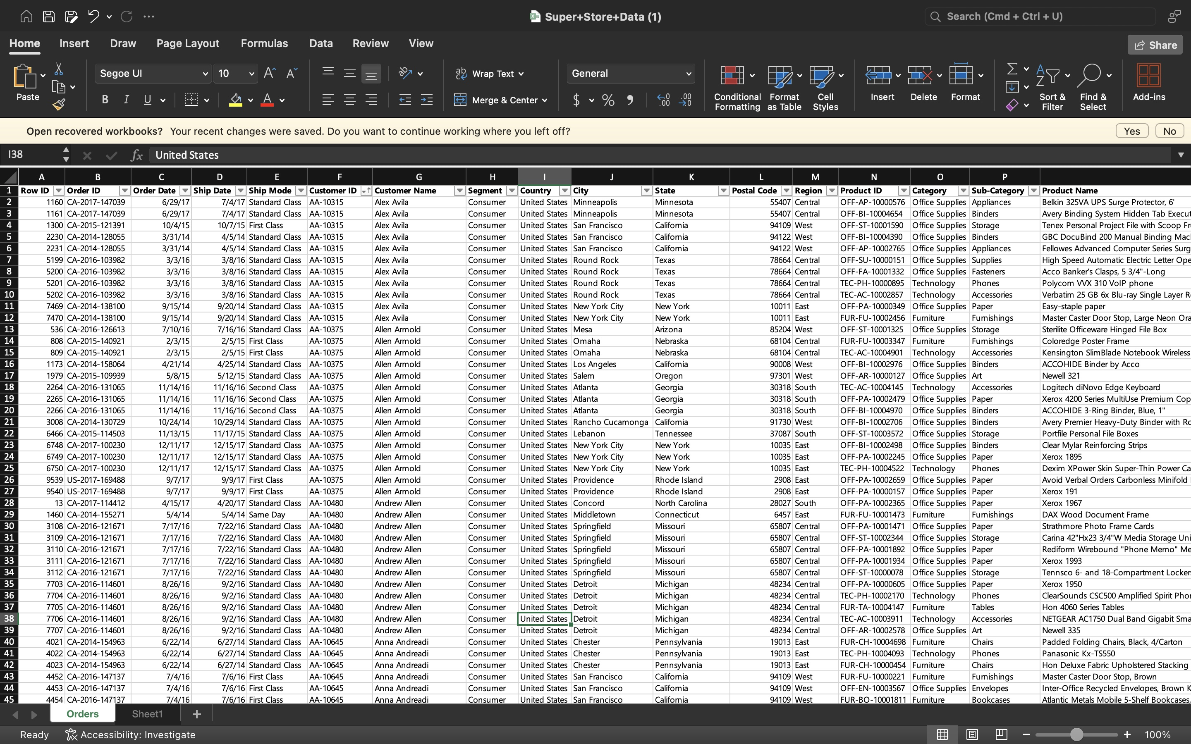
OBTAINING THE EXCEL FILE
The first step in this project is obtaining the excel file to work it.
You can get data from many sources like Kaggle, cyclobold’s website and more
I got my dataset from a data science group.
The file was in xlsx format.

Slide 4
CLEAN THE EXCEL FILE
Upon getting the excel file, I cleaned it to prevent data redundancy and inconsistencies in my dataset.
Definitely I can clean this data with SQL, I found it a safer practice to clean it in excel first.
I removed unnecessary duplicate data, corrected data types, and the date formats.

Slide 5
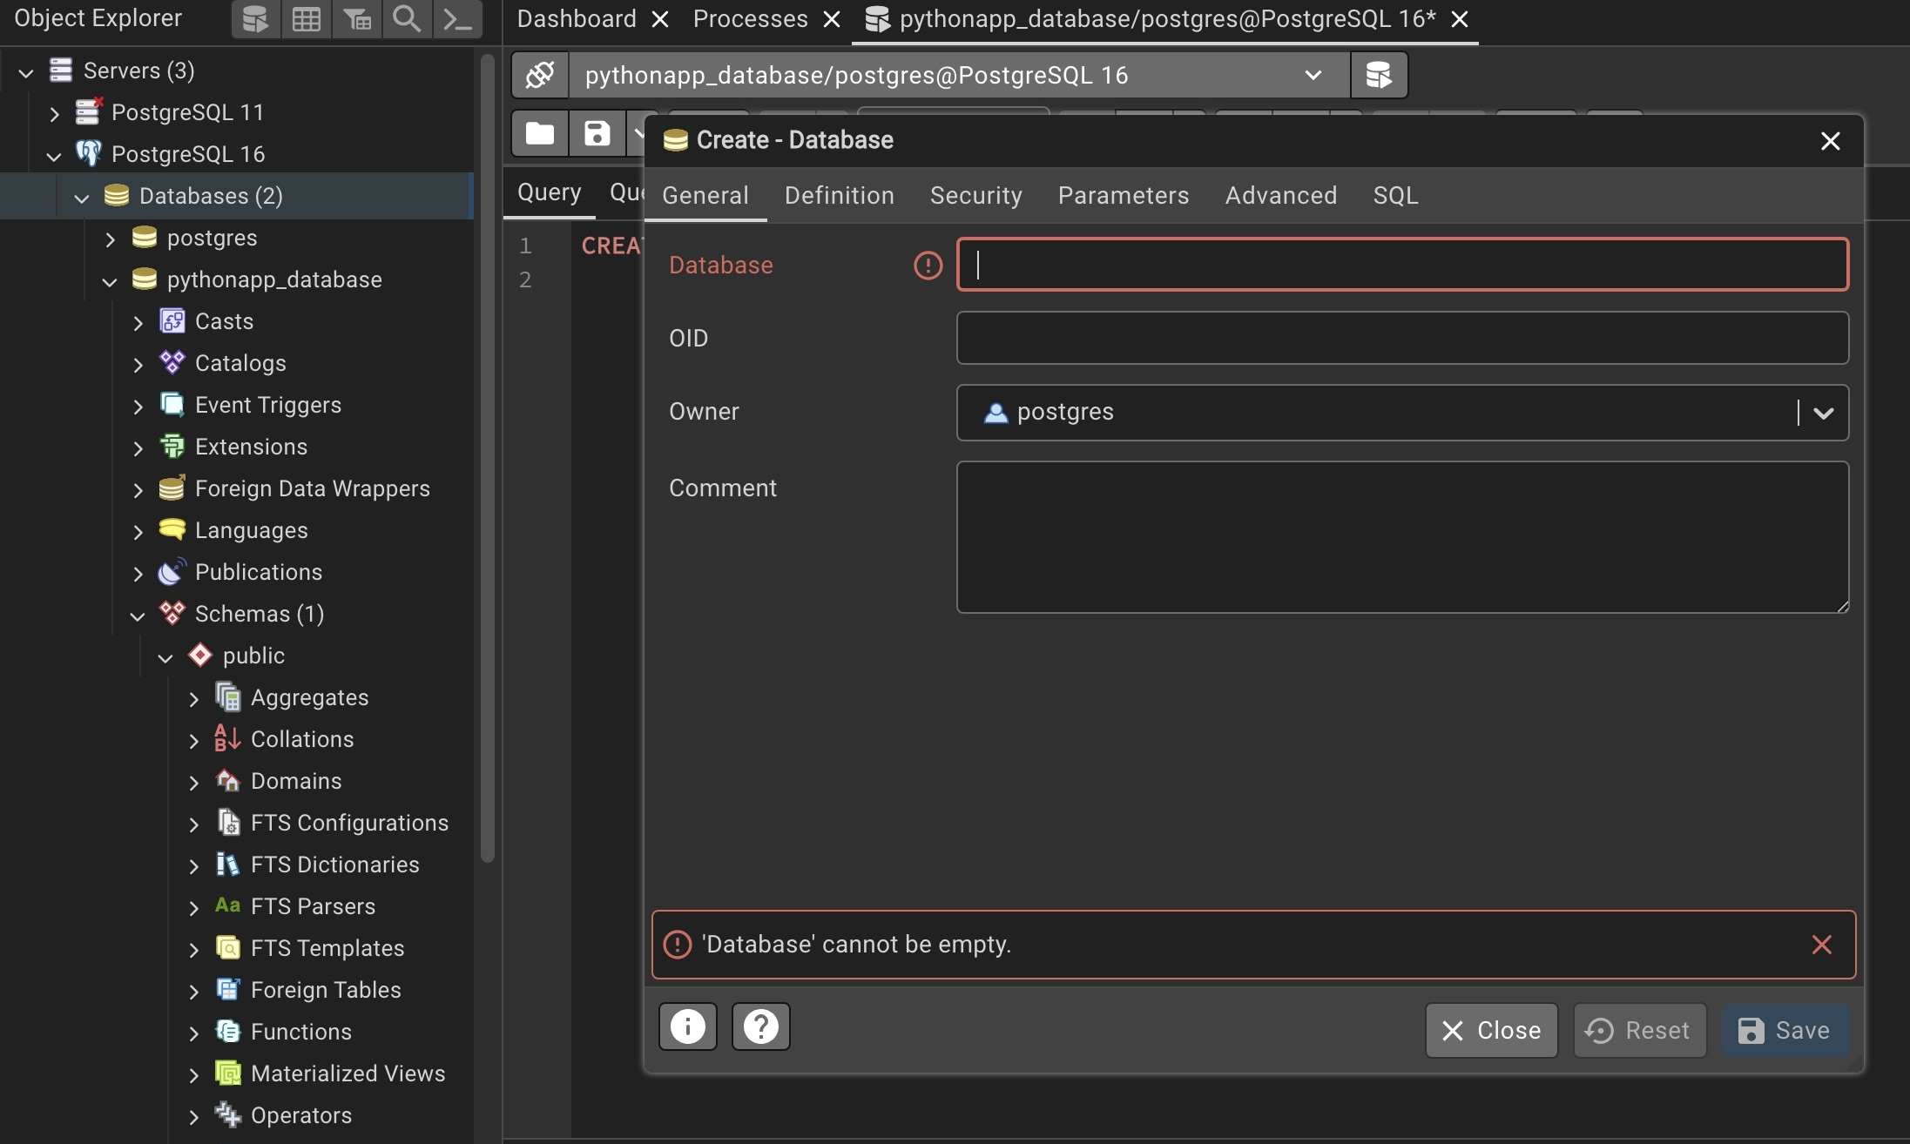
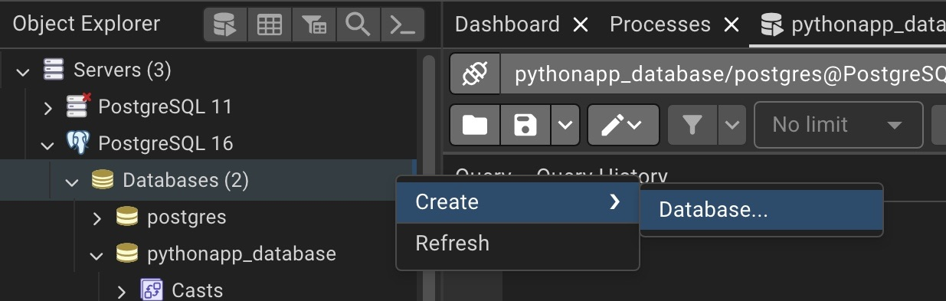
CREATE THE SQL DATA BASE
For this project I used a Postgres database server.
I created the database “pythonapp_database“ without a query.
You can also use the query “CREATE DATASBASE `database_name`;” to create your database.

Slide 6
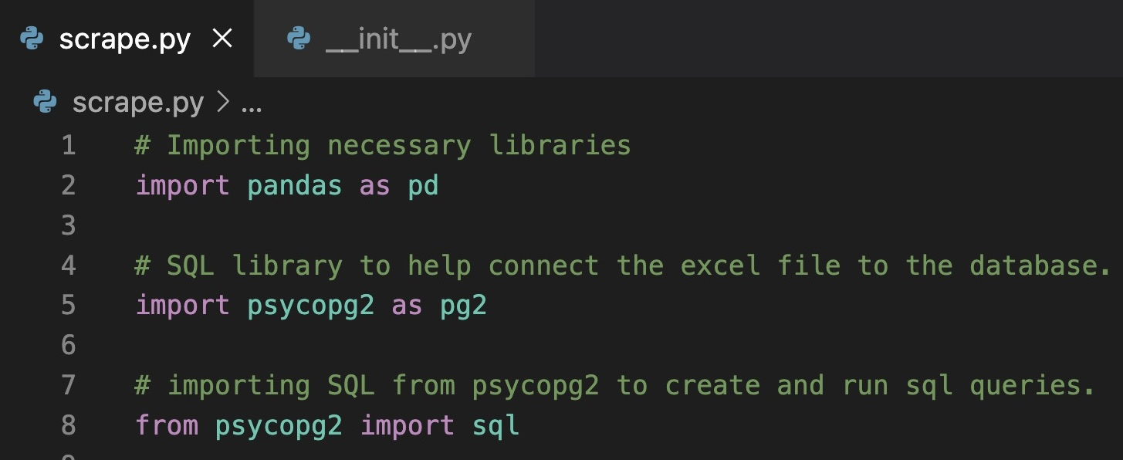
IMPORTING NECESSARY LIBRARIES IN PYTHON
Now that my excel file and data base were ready, I needed to import the necessary python modules via my terminal to enable the readability of my excel file in Python and the connection of Python to SQL for the insertion of the dataset.
I installed the python modules using the “pip3 install pandas” and the “pip3 install pysopg2”.
Code Snippet

Slide 7
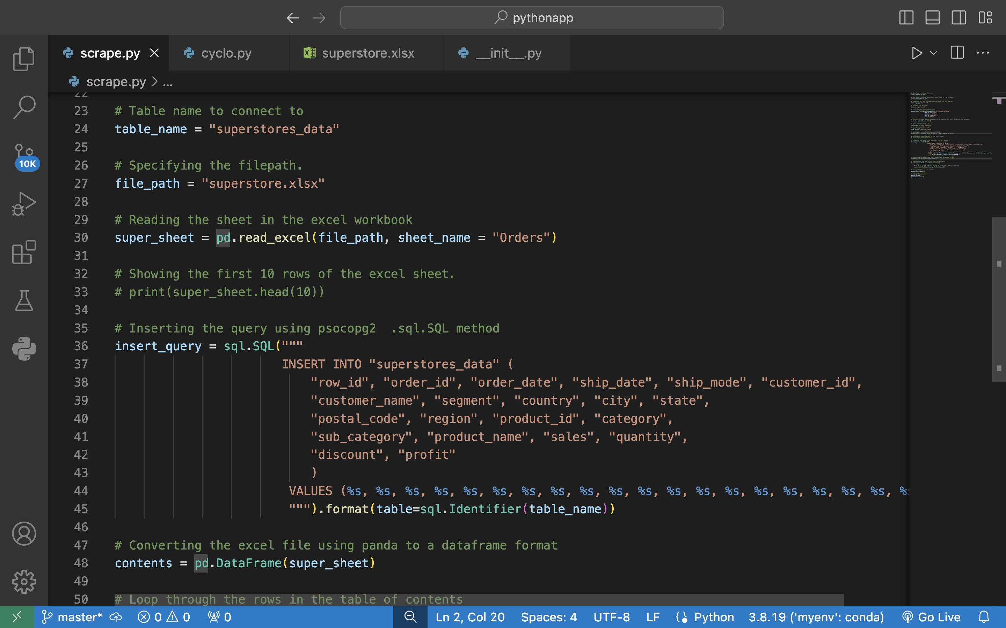
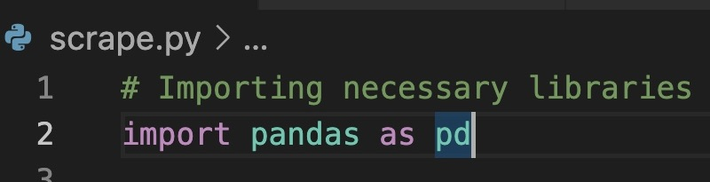
Reading The File Using Pandas
Pandas was previously installed to help read the excel files.
Panda will also help our excel data into a data-frame for easy data manipulation.

Slide 8
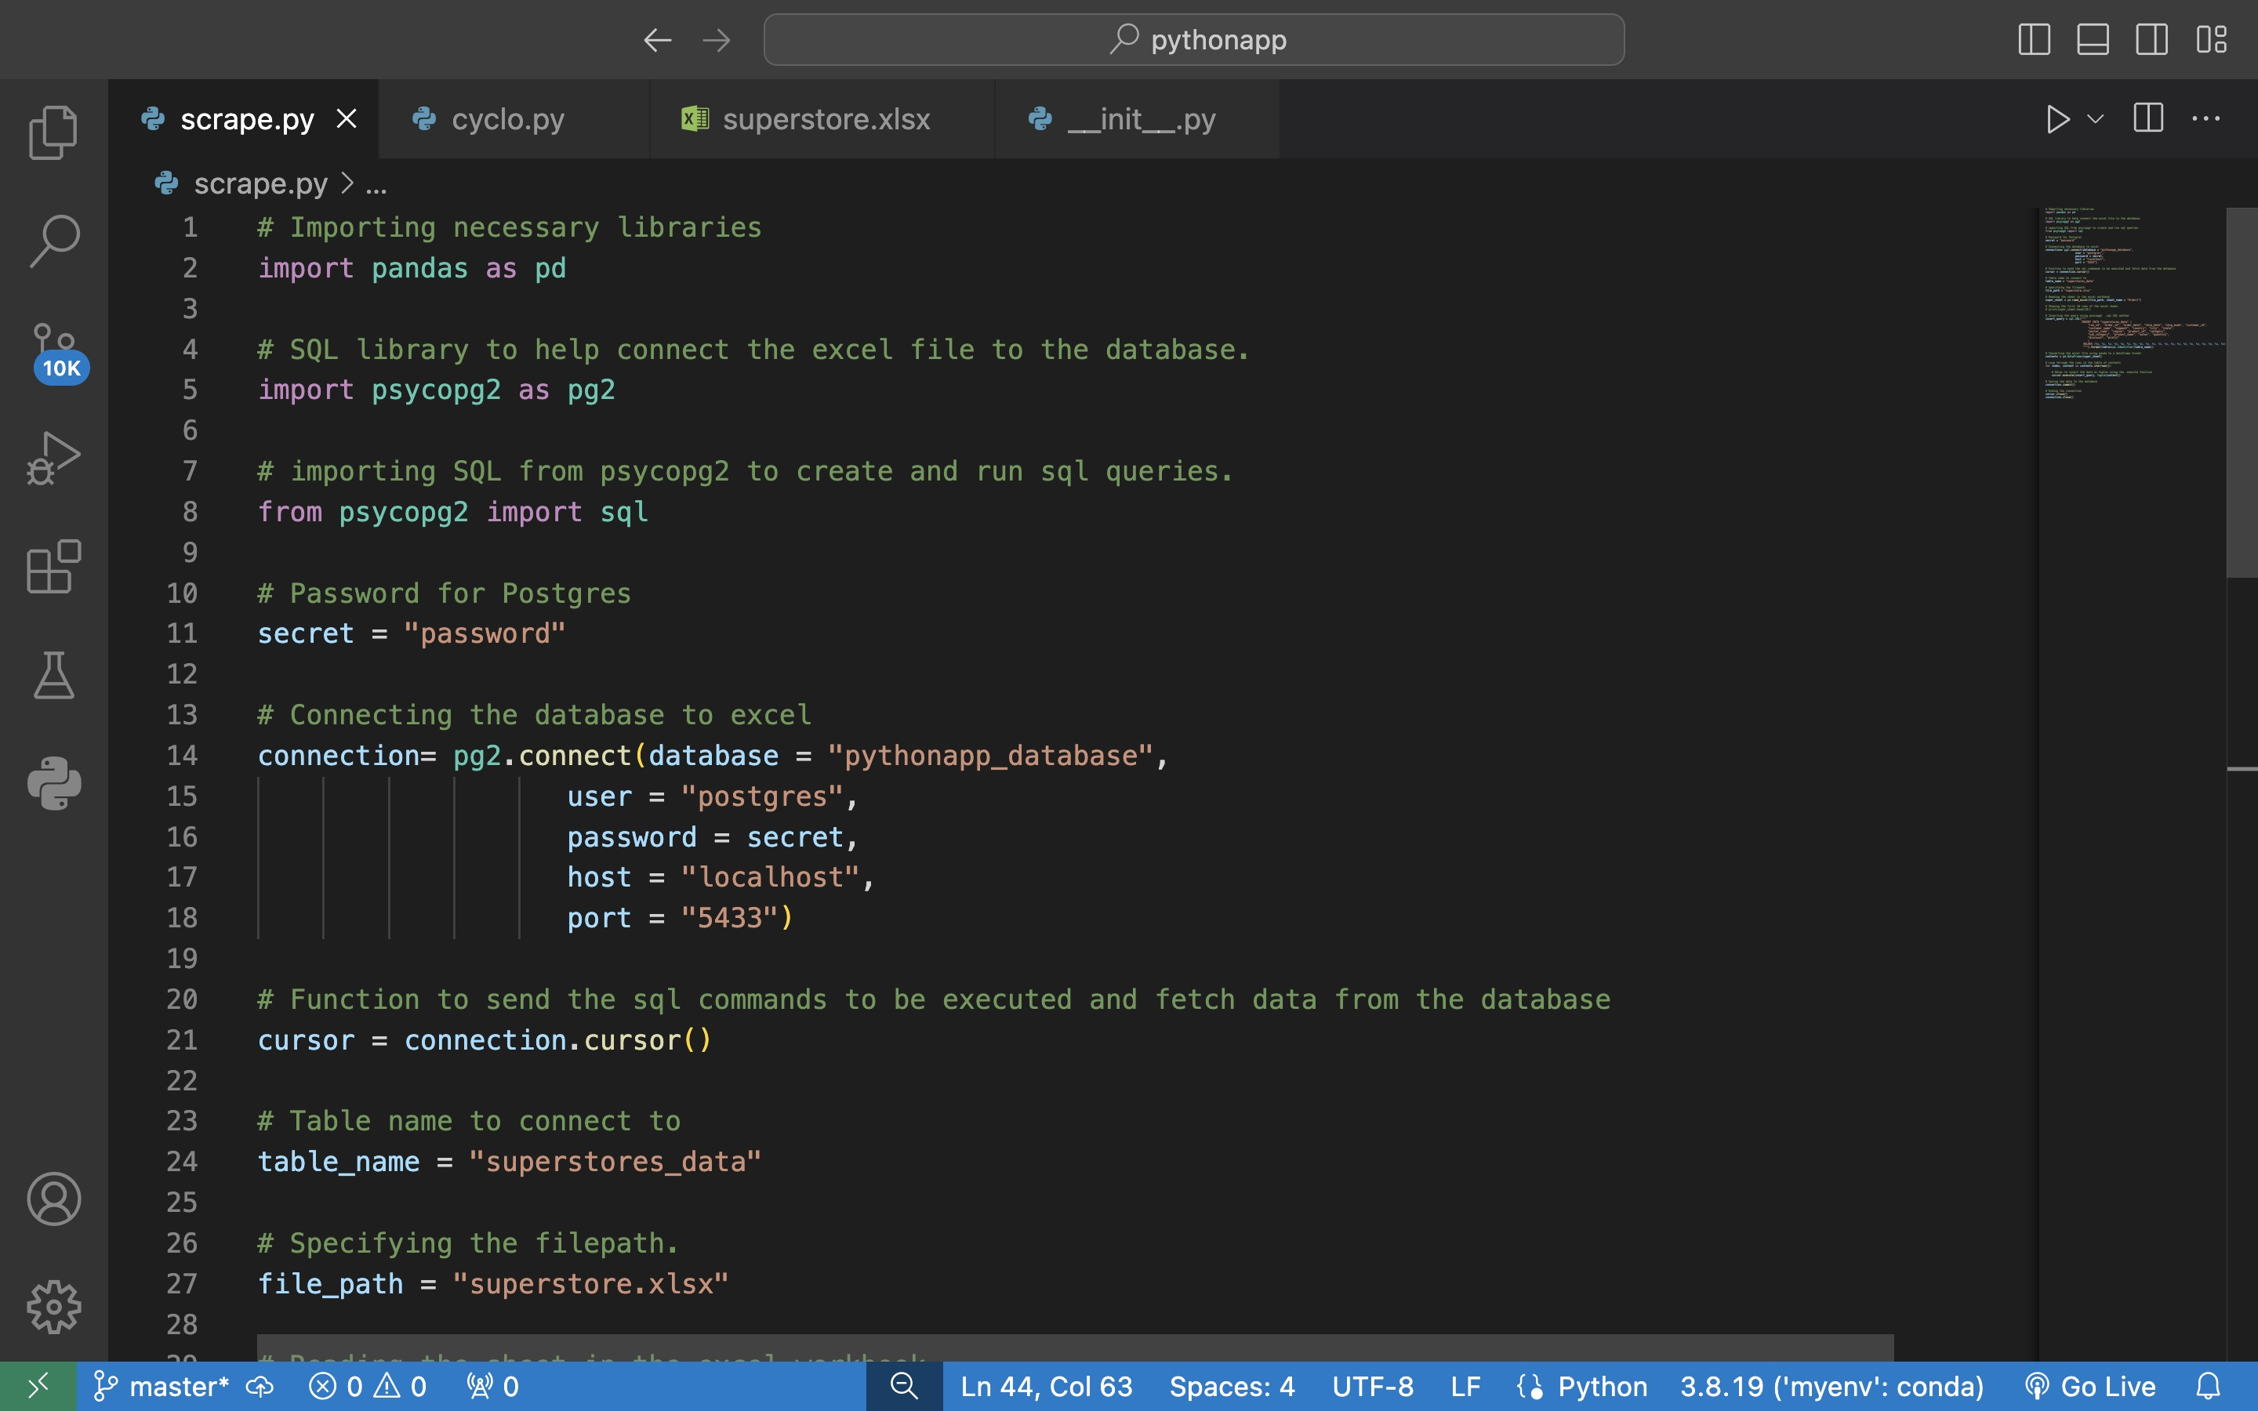
CREATING SQL CONNECTION USING PSCOPG2
To create the connection we’d import the psocopg2 module first.
After which we’d create a database connection using the database parameters.
WE then use .cursor function to send out the SQL commands to be executed and to interact with the database.

Slide 9
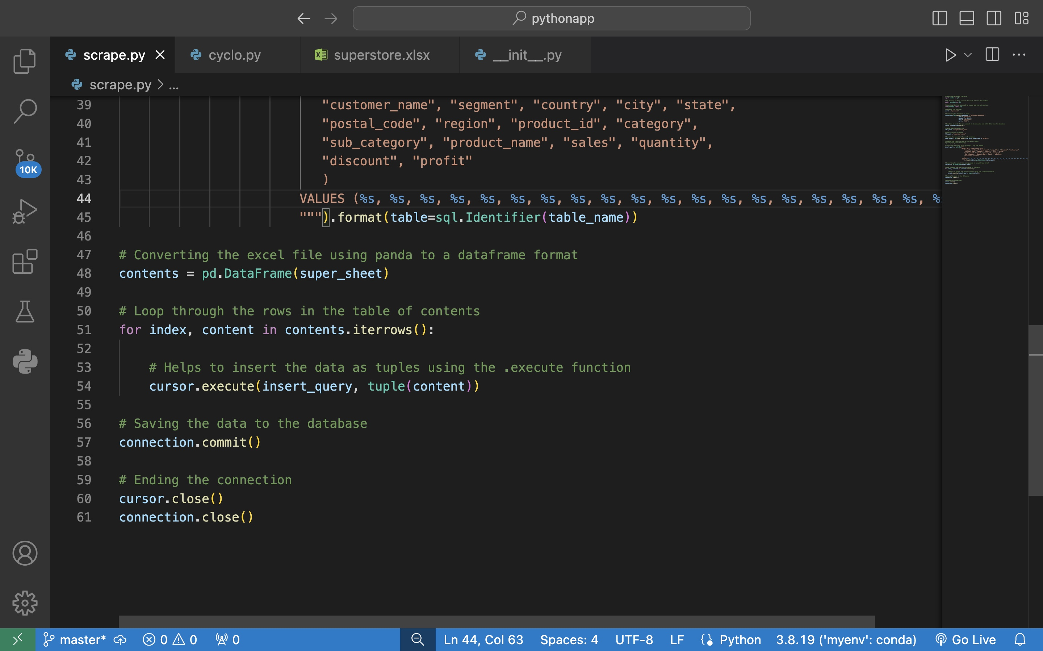
WRITE THE INSERT QUERIES USING SQL LIBRARY IN PSYCOPG2
Then we’d insert the query with the sql.SQL module we imported frompsycopg. This is to help the query out with the place holders.
I also using sql.identifier to identify the placeholders and to insert the query safely.

Slide 10
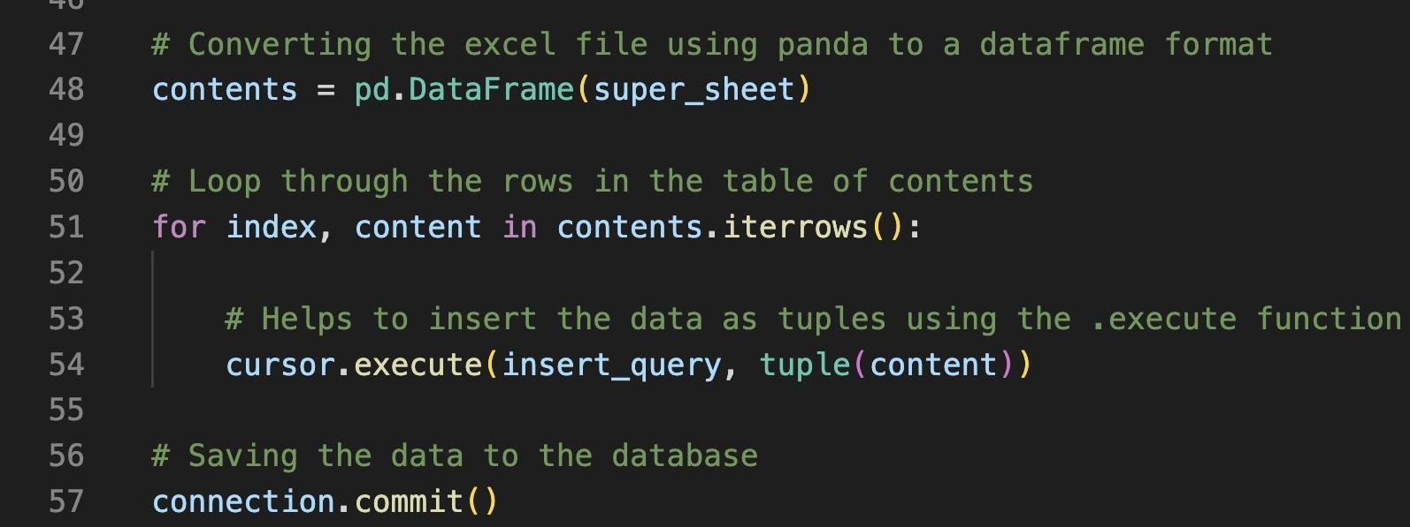
Send The Data As Tuples To The Postgres Database
We’d loop the file in the dataframe and send it as tuples.
.iterrows function will help loop through the each row index within the dataframe.
.execute to help execute the insertion of the dataset in postgres SQL database.
We save the data into the database using .commit function.

Slide 11
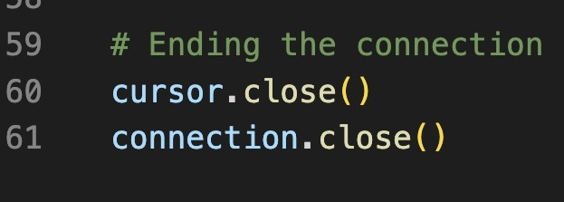
CLOSE THE CONNECTION FOR SAFE PRACTICES
We close the connection to sql for safe practices and to prevent data leakage.

Slide 12
CONCLUSION
Conclusively, we used panda and psocopg2 libraries to send in data from an excel worksheet into a postgres SQL database.
We were able to leverage on the data manipulation abilities from pandas while using psycopg2 to interact with our postgres SQL database.

Slide 13
THE END

